Slide 1
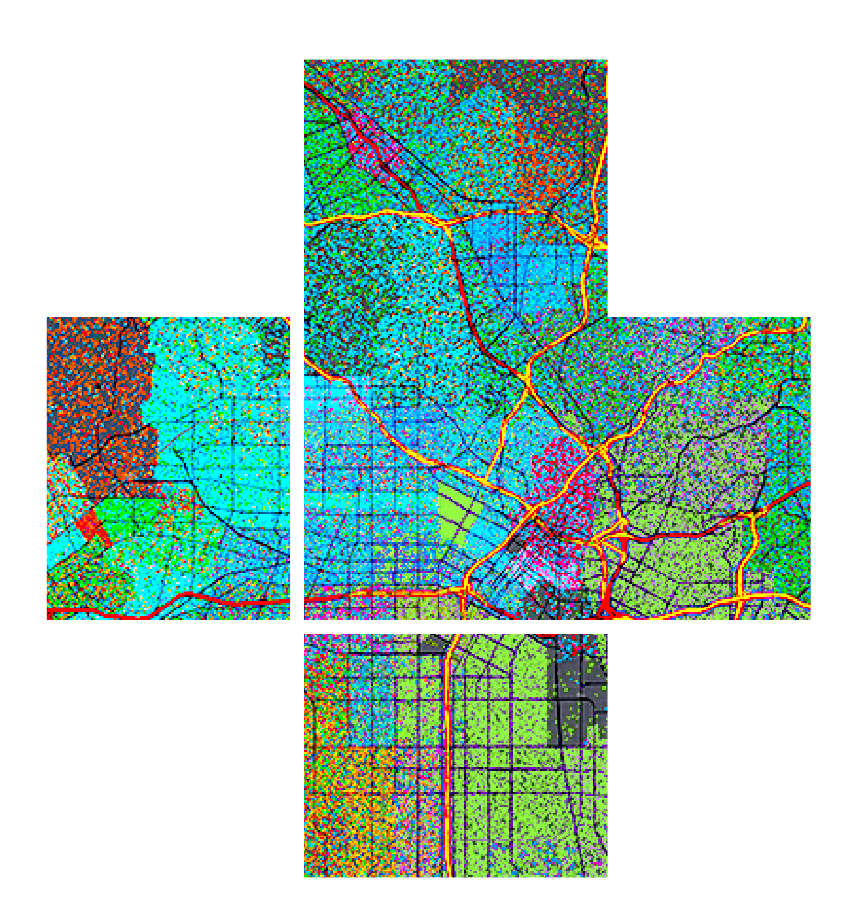








Practical Guide for Building a 3D Web App from 2D Data
Kristian Ekenes, Raluca Nicola
2020 ESRI DEVELOPER SUMMIT

Slide 2





Kristian Ekenes
Raluca Nicola
Product Engineer JS API
Product Engineer JS API
Data visualization, Smart Mapping, Arcade, Geometry Engine
Data visualization, 3D Cartography
Redlands, California
Zurich, Switzerland
Notes:
Not sure if this slide is worth it. We present ourselves anyway

Slide 3
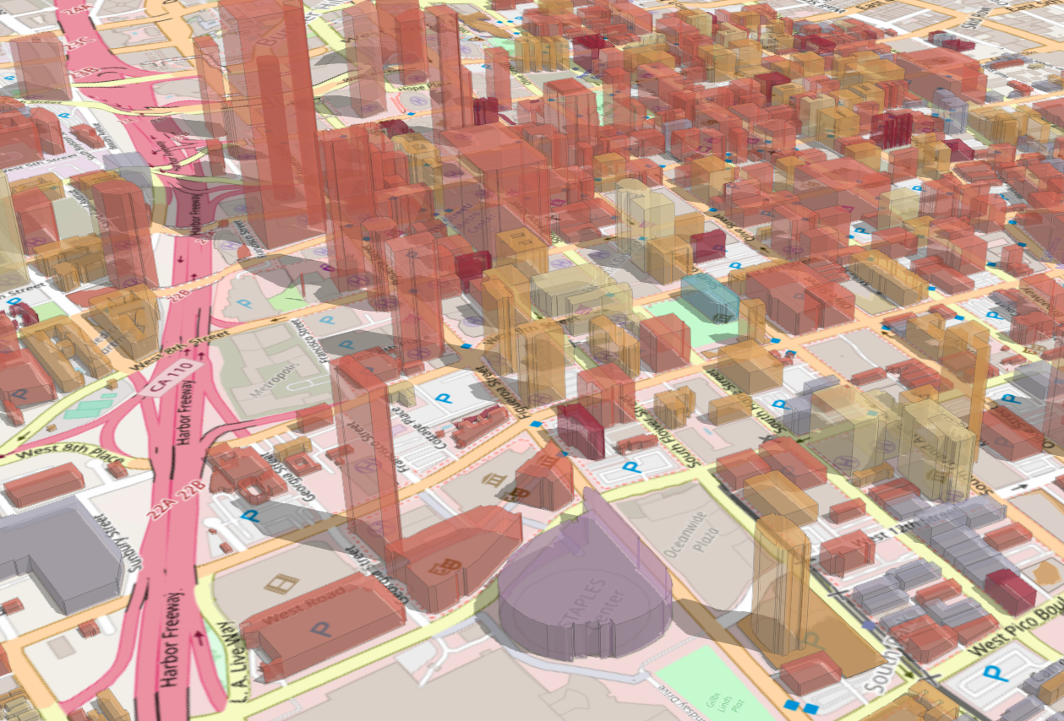
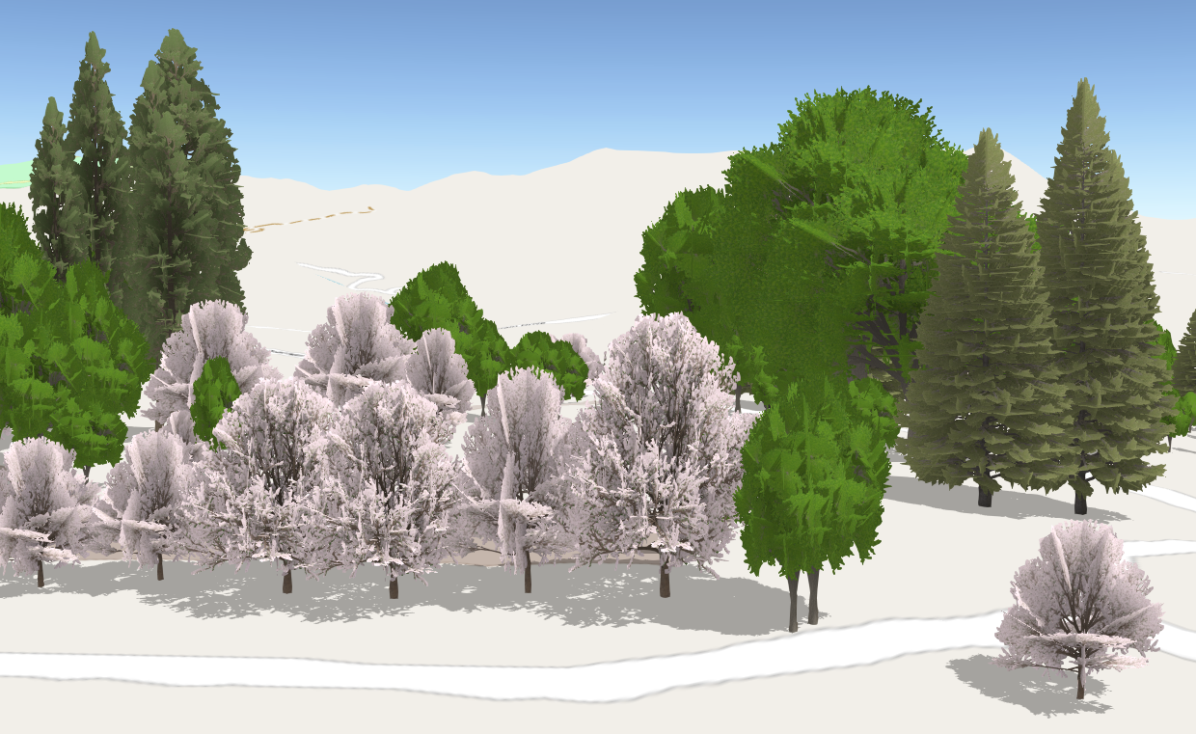
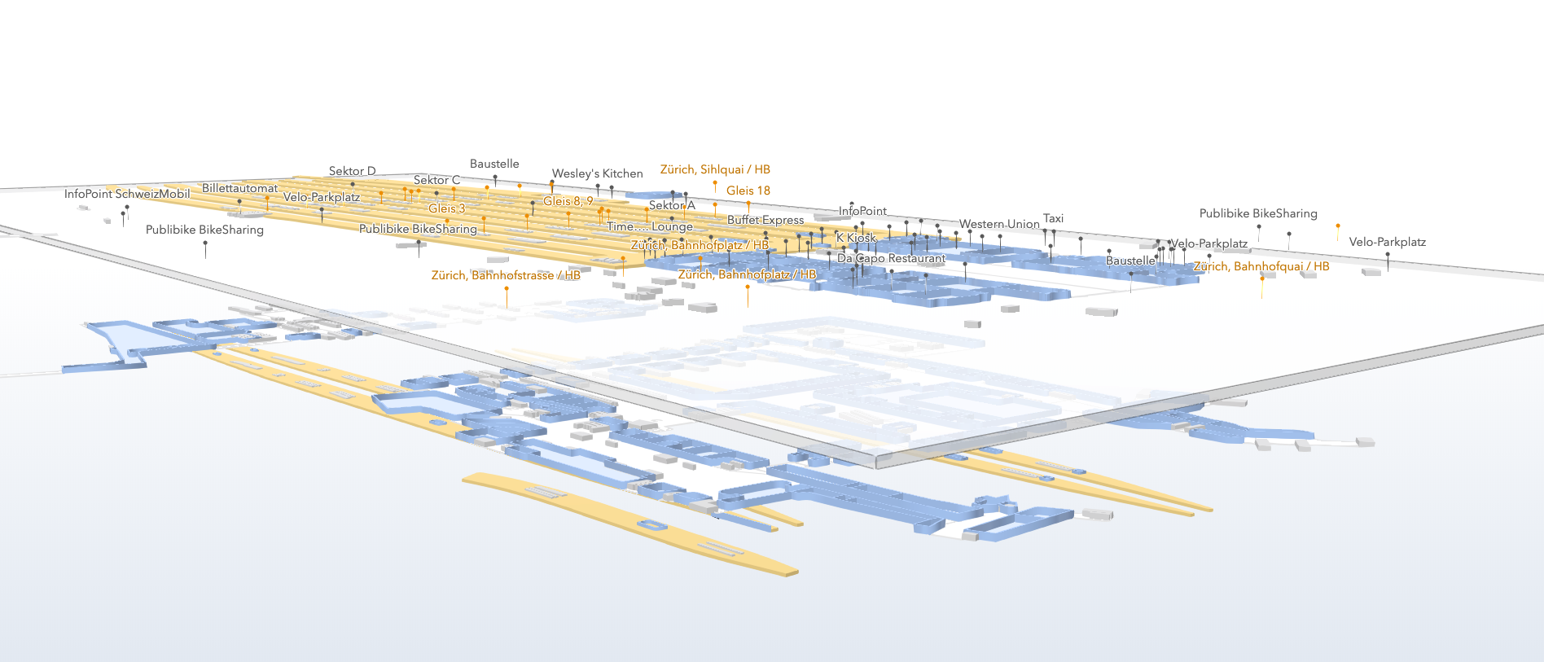
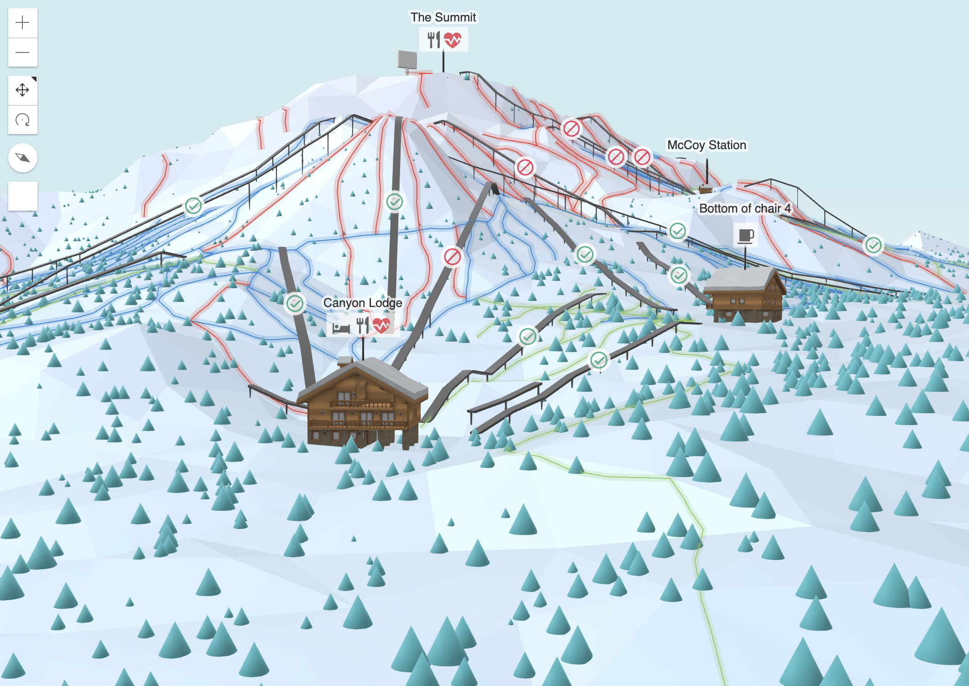
Other examples
and resources
City visualizations
20 min
15 min
20 min
5 min
Train station plan
Ski resort map

Slide 4
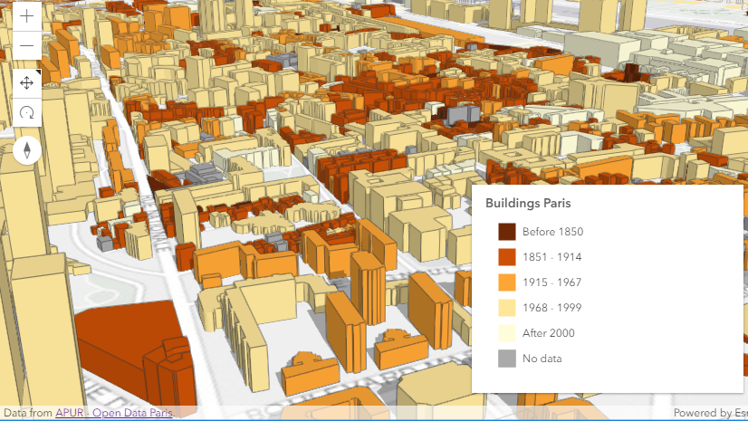
City visualizations
Building a city analysis app from building footprints

Slide 5
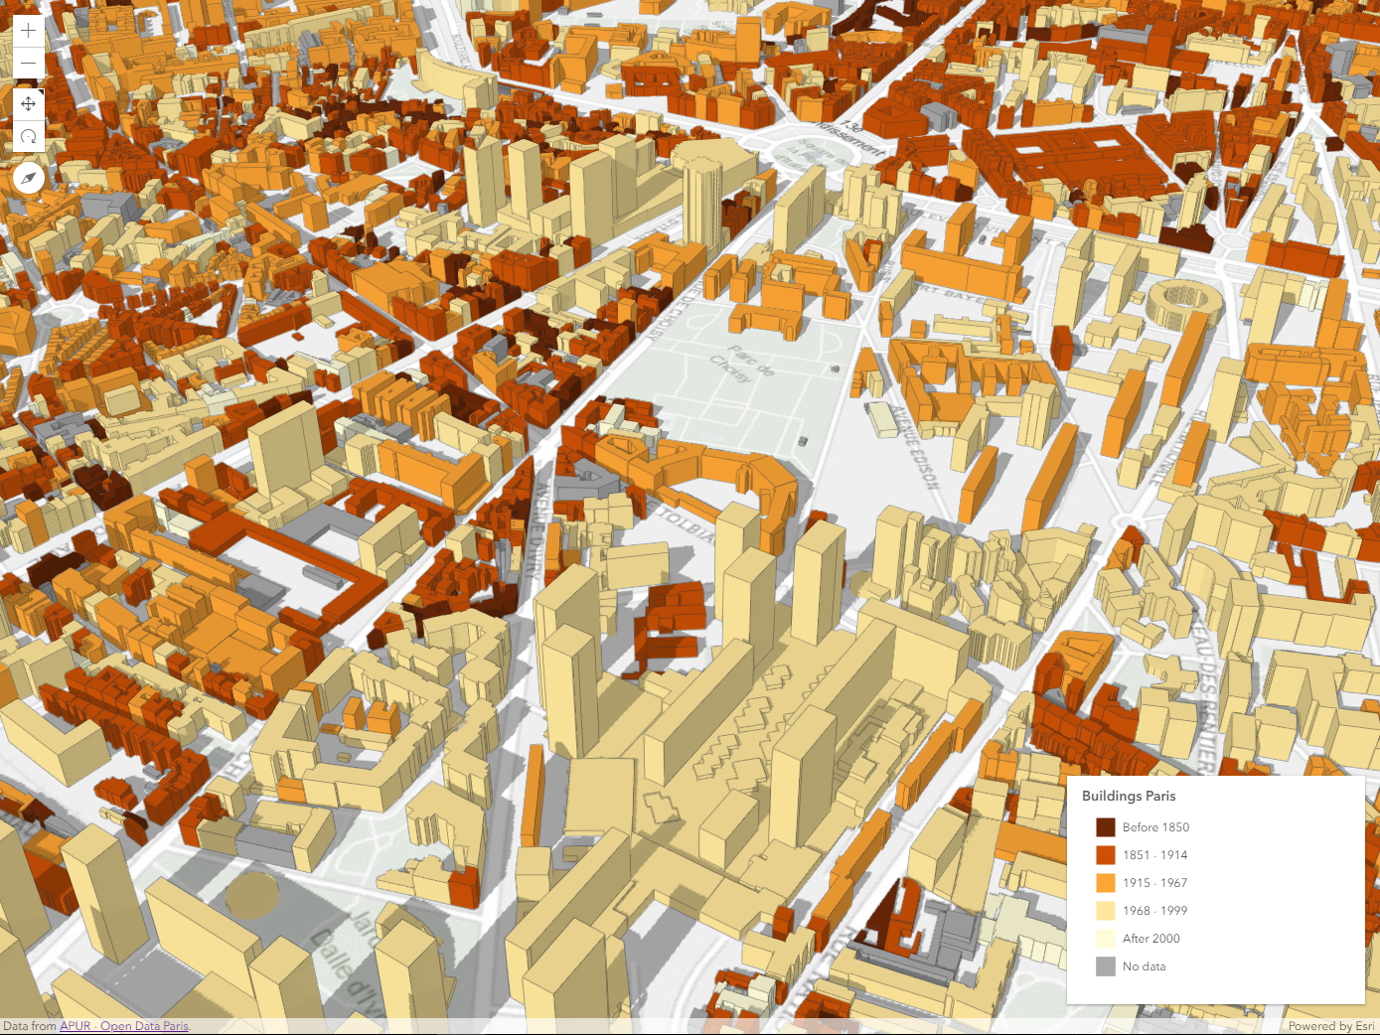
Resources
Open Data portals – building footprints
ESRI basemaps & elevation services
ESRI Web Styles
ArcGIS API for
JavaScript

Slide 6
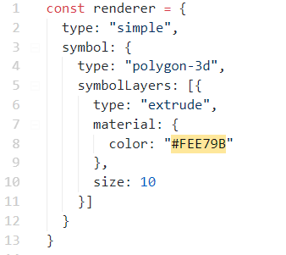



Building footprint extrusion
10 meters

Slide 7
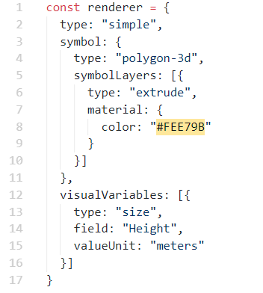
Building footprint extrusion
$feature.Height

Slide 8
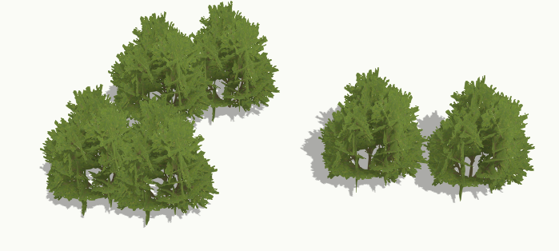
3D models – WebStyleSymbols

Slide 9
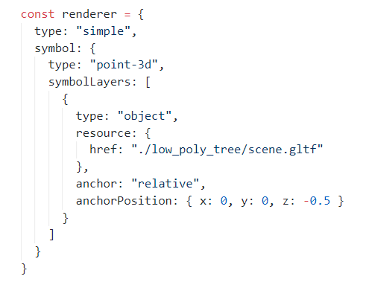
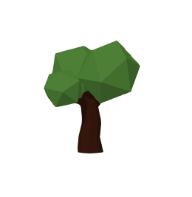
3D models - glTF

Slide 10
Raluca Nicola

Slide 11
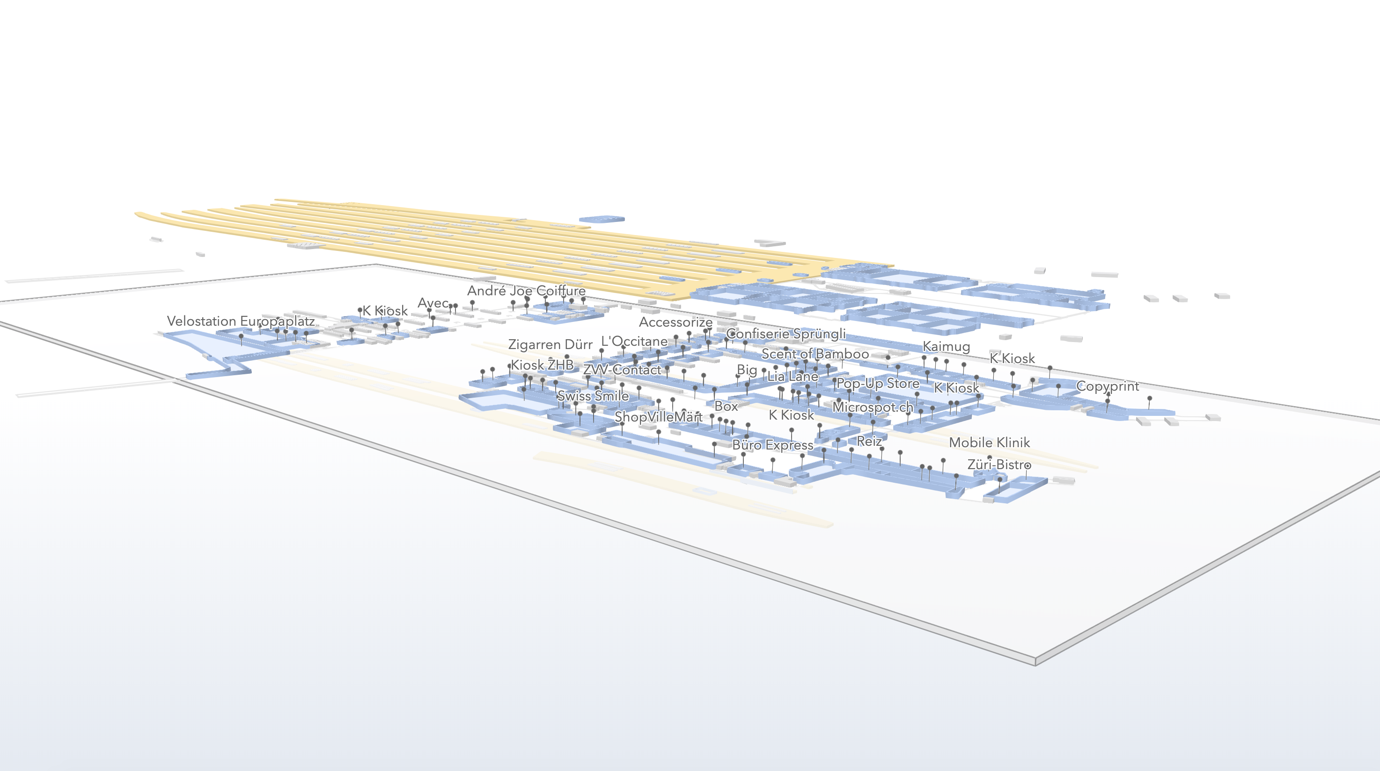
3D plan of a train station
Building it from GeoJSON data with floor attributes
Live application:
https://ralucanicola.github.io/JSAPI_demos/zurich-hb/
https://github.com/RalucaNicola/JSAPI_demos/tree/master/zurich-hb
Code:

Slide 12
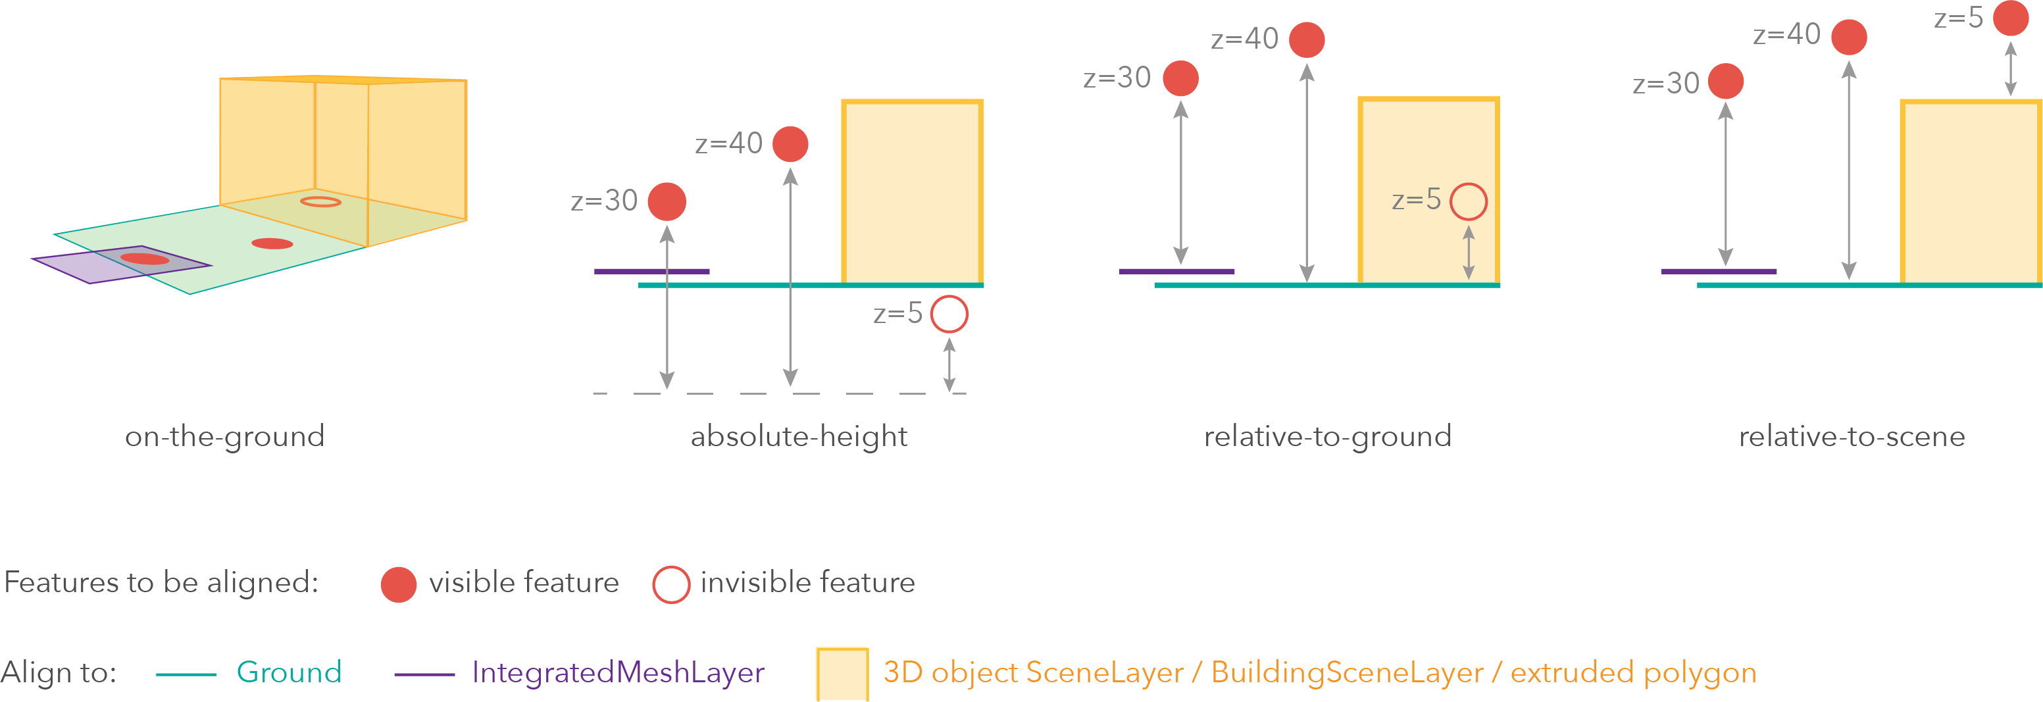
Elevation Info – different elevation modes

Slide 13
Elevation Info – expression from attribute values

Slide 14
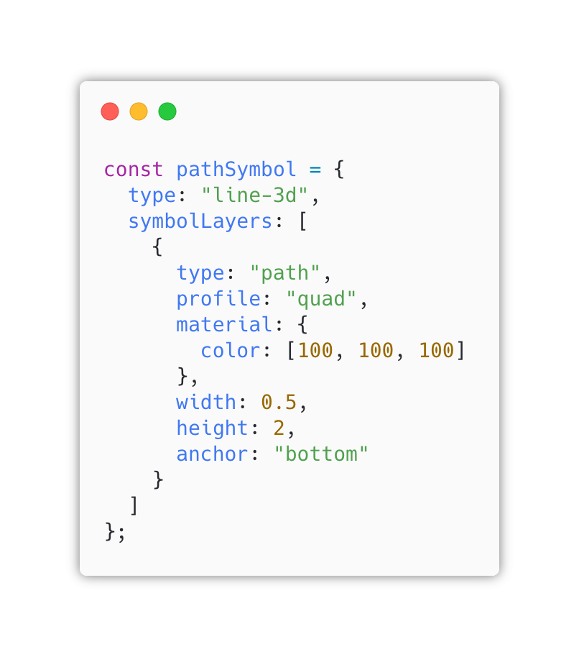
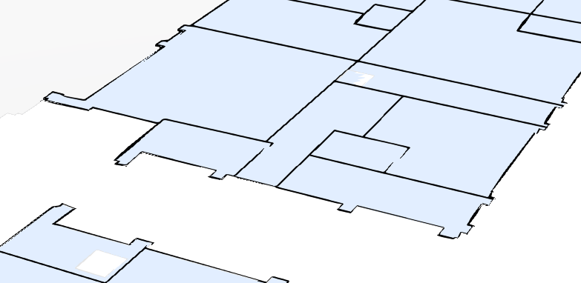
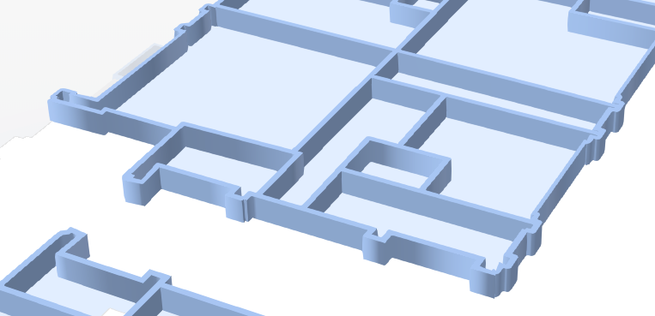
3D symbols for 2D lines – PathSymbol3DLayer

Slide 15
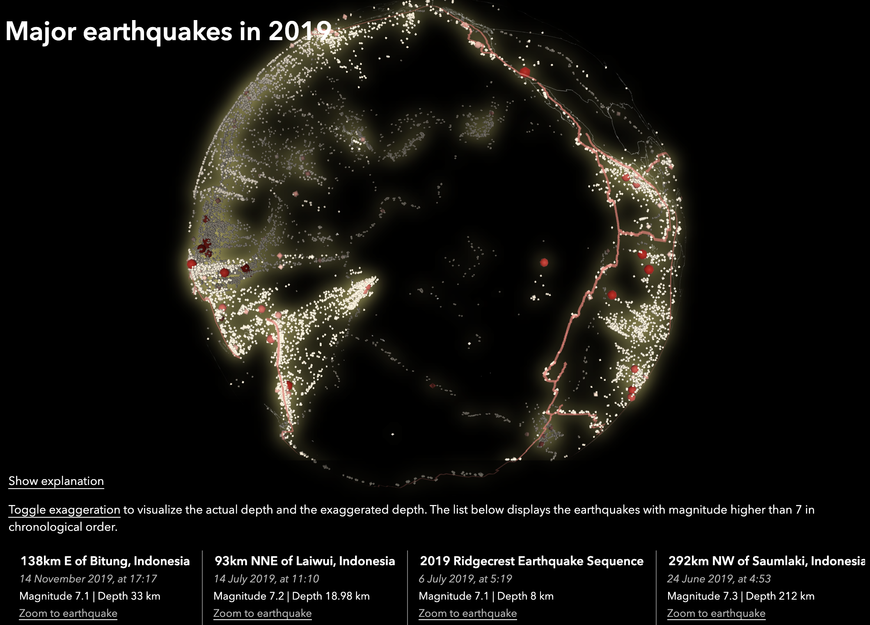
Earthquakes globe
Visualize earthquakes in 2019 with exaggerated depth on a globe
Live application:
https://ralucanicola.github.io/earthquakes-viz/
https://github.com/RalucaNicola/earthquakes-viz
Code:

Slide 16
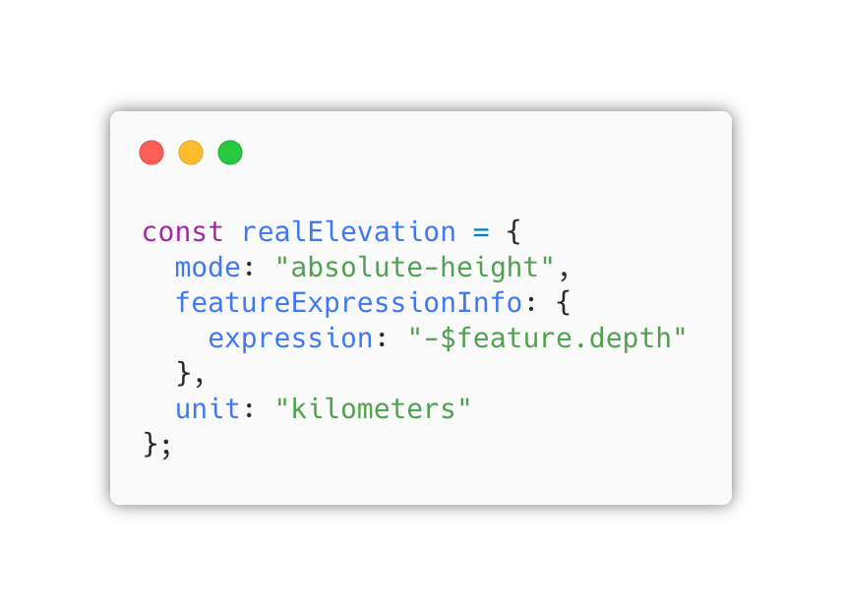
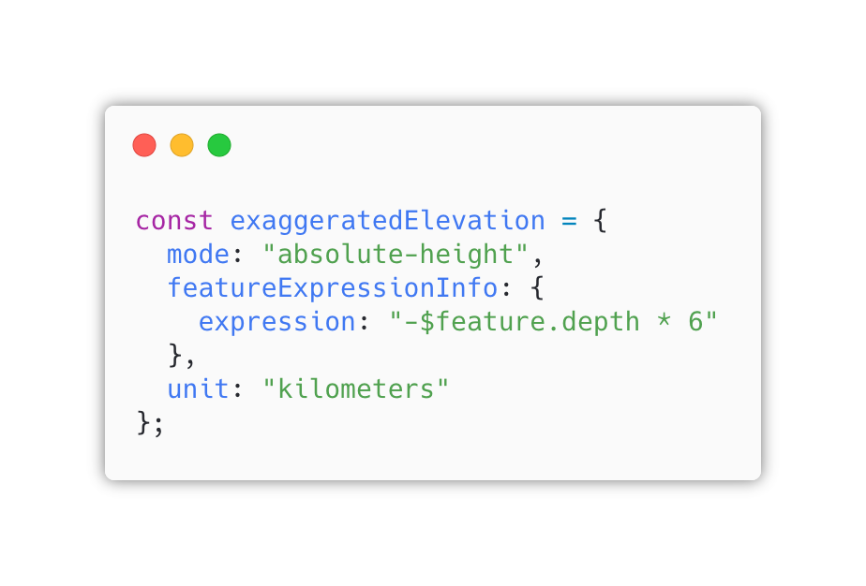
Set Arcade expression to derive elevation from existing fields

Slide 17
Ski resort
Create a playful 3D visualization of a ski resort by deriving the height from the elevation service
Live application:
https://ralucanicola.github.io/ski-resort-map/
Code:
https://github.com/RalucaNicola/ski-resort-map

Slide 18
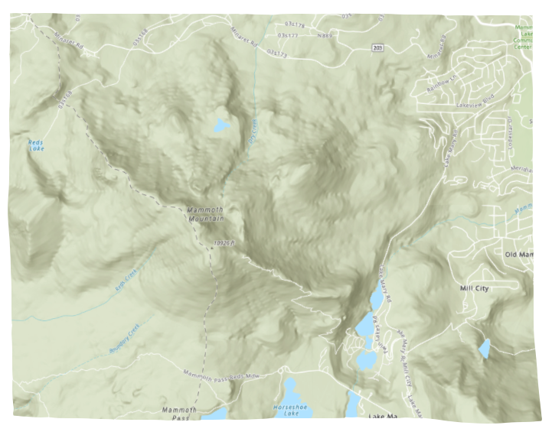
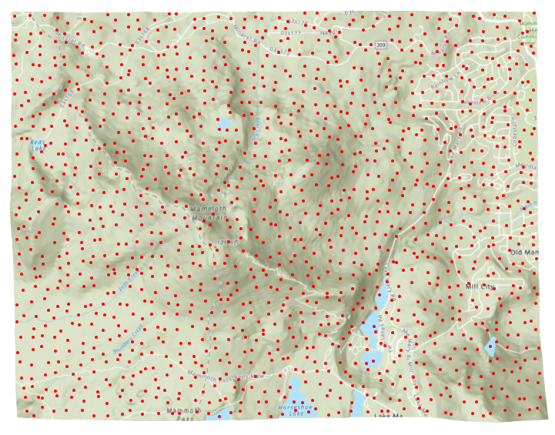
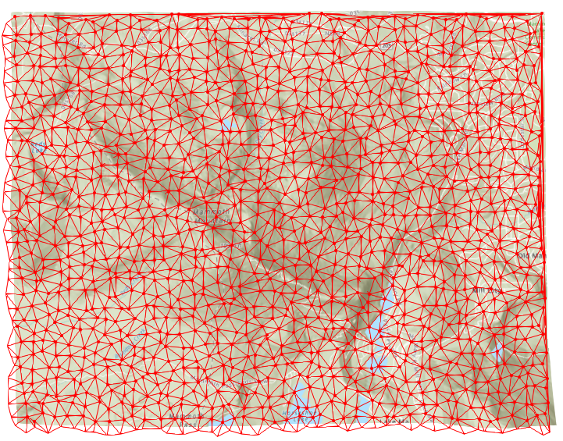
Use the Mesh API to create a low-poly terrain from points
Generate random points for the selected extent
Triangulate the points

Slide 19
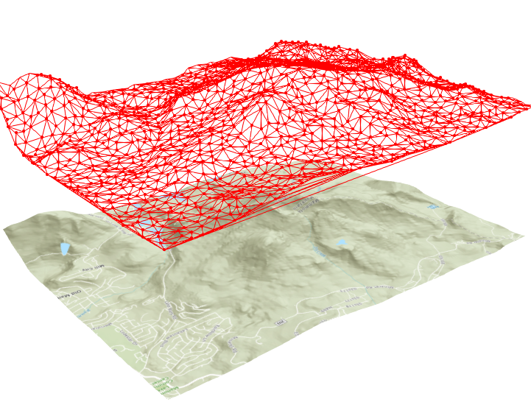
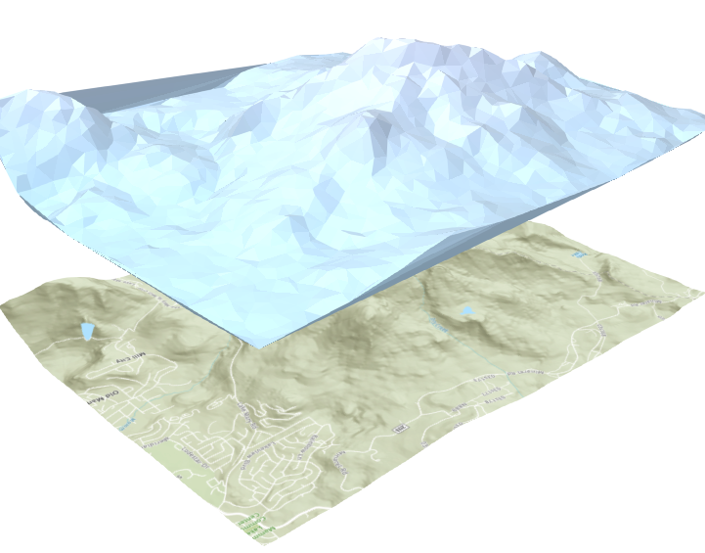
Use the Mesh API to create a low-poly terrain from points
Use elevation queries to set z values
(in this map elevation is 2 times exaggerated)
Use mesh API to create the 3D geometry

Slide 20
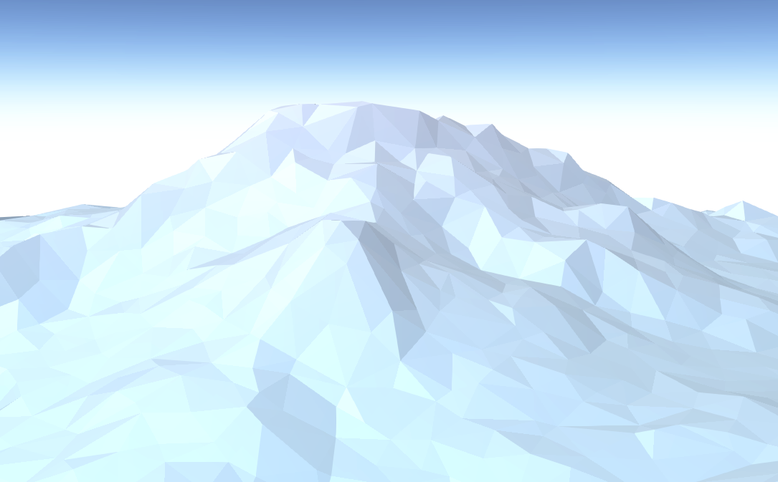
Use the Mesh API to create a low-poly terrain from points

Slide 21
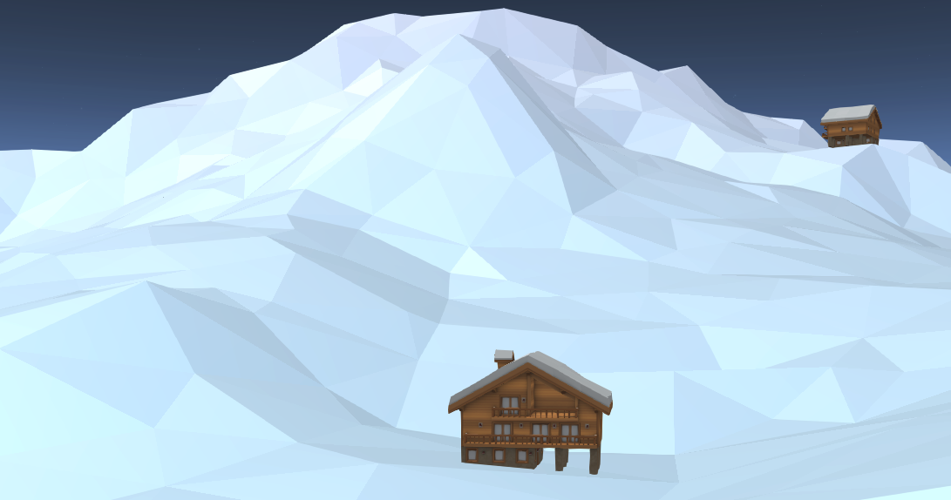
Symbolize points using GLTF models
3D model source: https://poly.google.com/view/6ufSK2nQBc6

Slide 22
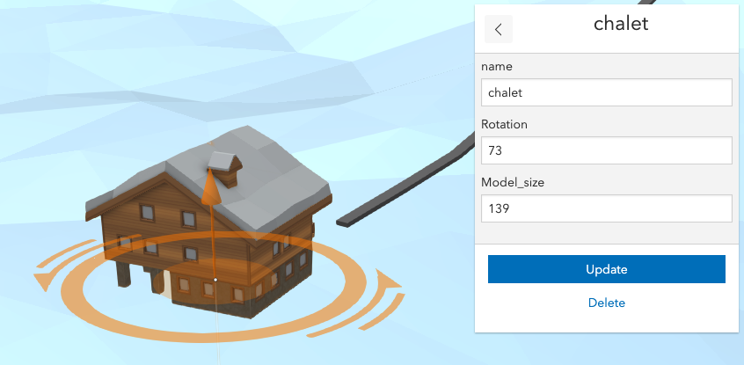
Use the editor to set height, size and heading of the model
3D model source: https://poly.google.com/view/6ufSK2nQBc6

Slide 23
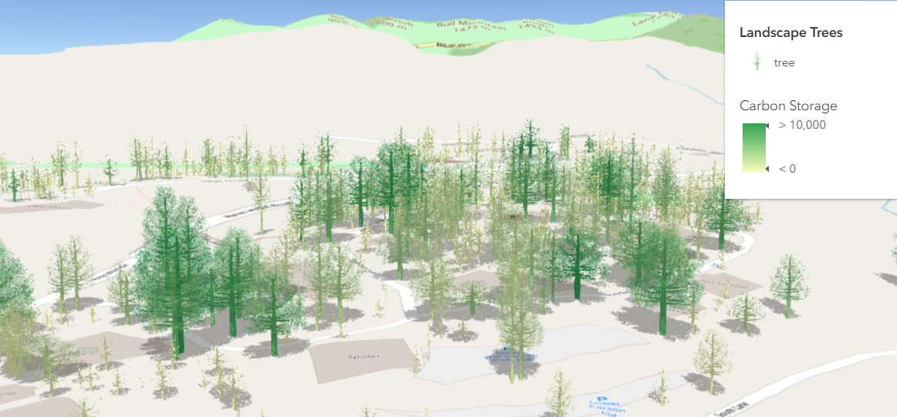
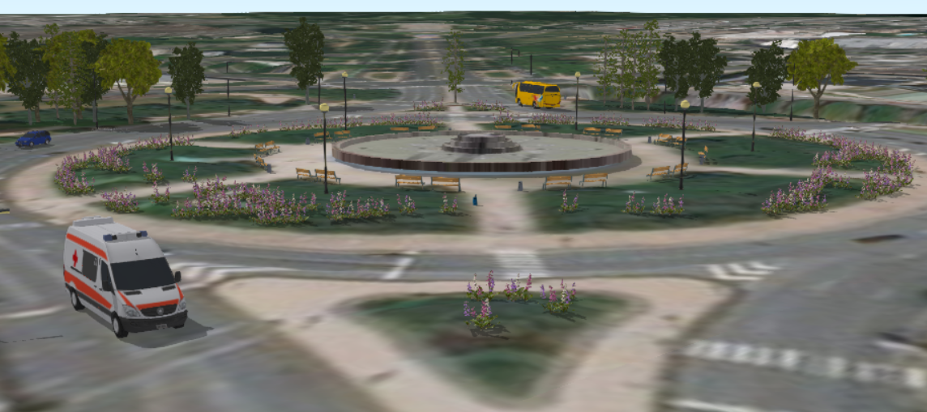
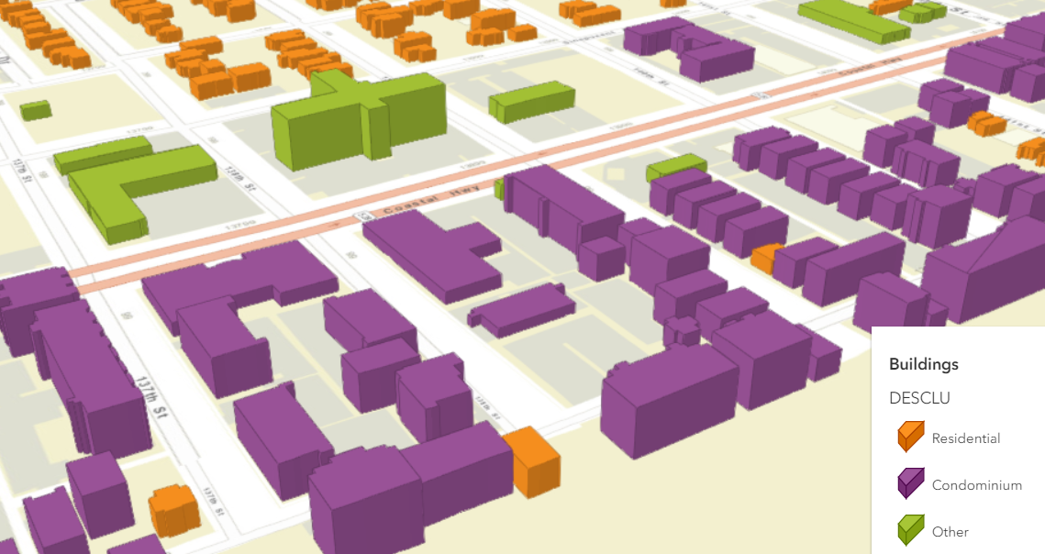
Documentation samples
https://developers.arcgis.com/javascript/latest/sample-code/visualization-webstylesymbol/index.html

Slide 24
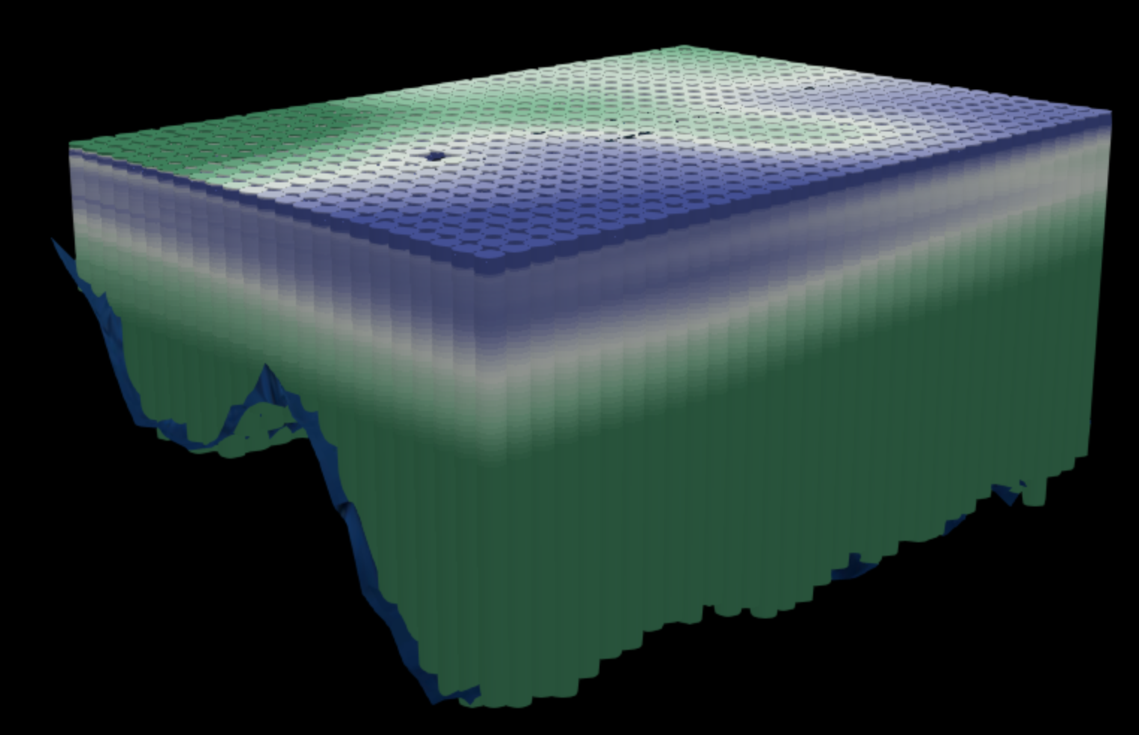
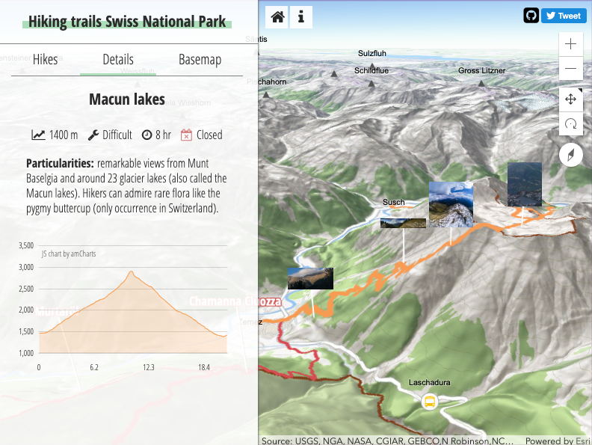
Other examples
Earthquakes
Ocean salinity
Hiking trails

Slide 25
More resources
ArcGIS API for JavaScript SDK samples:
https://developers.arcgis.com/javascript/latest/sample-code/index.html?search=webstyle
Making the leap to 3D - http://www.esri.com/esri-news/arcuser/fall-2017/making-the-leap-to-web-3d (ArcUser article)
Visualize large feature datasets in 3D with ArcGIS API for JavaScript - https://www.esri.com/arcgis-blog/products/js-api-arcgis/3d-gis/visualize-large-feature-datasets-in-3d-with-arcgis-api-for-javascript/

Slide 26
Creating an interactive 3D hiking map - https://www.esri.com/arcgis-blog/products/js-api-arcgis/mapping/creating-3d-hiking-map/
A 3D globe of earthquakes - https://www.esri.com/arcgis-blog/products/js-api-arcgis/3d-gis/3d-globe-earthquakes/
Visualize large feature datasets in 3D with ArcGIS API for JavaScript - https://www.esri.com/arcgis-blog/products/js-api-arcgis/3d-gis/visualize-large-feature-datasets-in-3d-with-arcgis-api-for-javascript/

